Slide 1
Objectives
In this session, you will learn to:
  Explore your computer
Notes:
Share the session objectives with the students.

Slide 2

Exploring Your Computer
What is Windows Explorer?

Slide 3
Exploring Your Computer (Contd.)
Windows Explorer is an application. It helps you to view and manage files and folders on your computer.

Slide 4
Exploring Your Computer (Contd.)
What are the components of Windows Explorer?

Slide 5
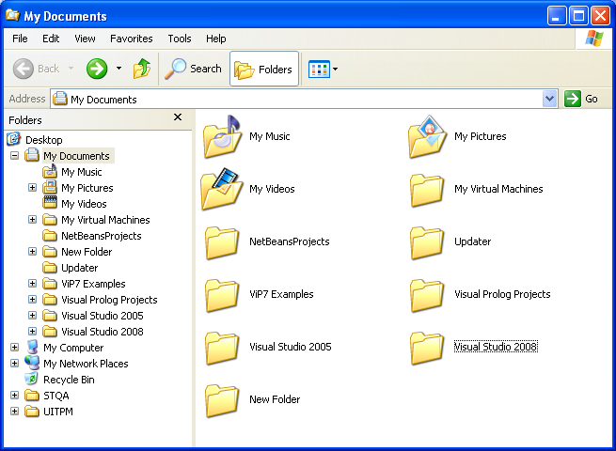
Exploring Your Computer (Contd.)
The following figure shows Windows Explorer and its components.
Toolbar
Folders
Pane
Contents
Pane
Plus
Sign

Slide 6
Exploring Your Computer (Contd.)
Folders pane:
  It displays the folders in a hierarchical structure.
  A plus sign (+) icon appears with the folders, containing sub folders.
  Its primary folders are:
    My Documents
    My Computer
    My Network Places
    Recycle Bin

Slide 7
Exploring Your Computer (Contd.)
Contents pane:
  It displays the files and sub folders of the selected folder in the folder pane.
  The view of the contents pane can be modified by using the View menu.
  The View menu consists of the following options:
    Thumbnails
    Tiles
    Icons
    List
    Details

Slide 8
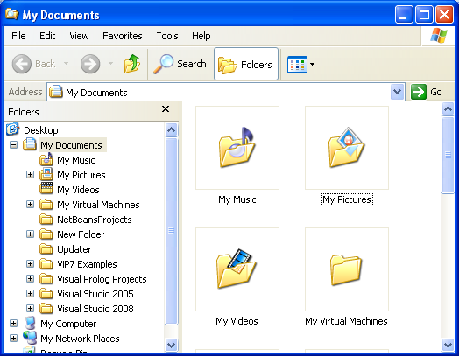
Exploring Your Computer (Contd.)
Let us see the Thumbnails view of the contents pane.

Slide 9
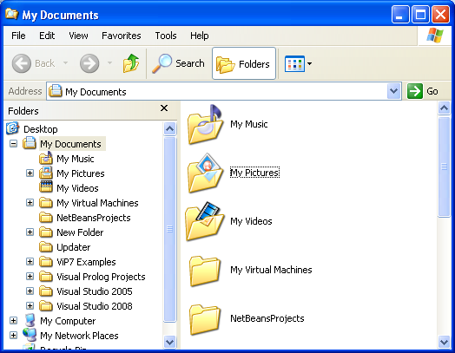
Exploring Your Computer (Contd.)
Let us see the Tiles view of the contents pane.

Slide 10
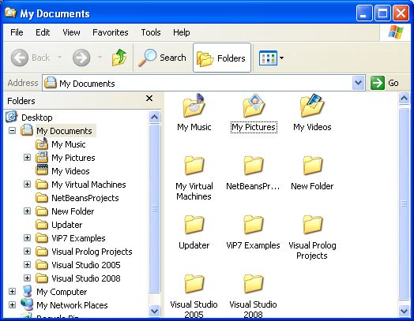
Exploring Your Computer (Contd.)
Let us see the Icons view of the contents pane.

Slide 11
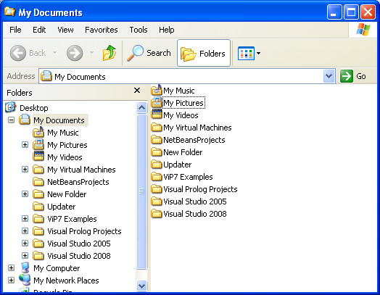
Exploring Your Computer (Contd.)
Let us see the List view of the contents pane.

Slide 12
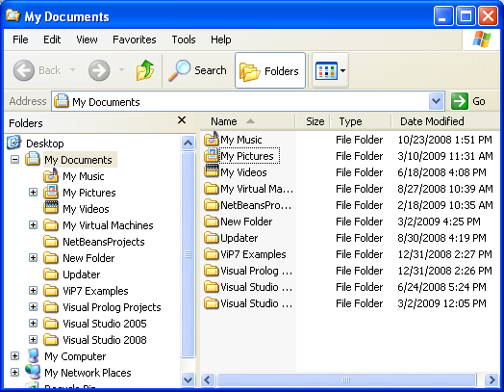
Exploring Your Computer (Contd.)
Let us see the Details view of the contents pane.

Slide 13

Exploring Your Computer (Contd.)
Toolbar:
  Displays shortcuts to the menu items.
  The following figure shows a Toolbar.
Forward button
Search button
Back button
View button
Up button
Folders button

Slide 14
Summary
In this lesson, you learned that:
  Windows Explorer is an application. It helps you to view and manage the files and folders on your computer.
  The Explorer window is divided into two panes:
    Folders pane
    Contents pane
  The Folders pane shows all folders and files in a hierarchical structure.
  A plus sign (+) icon appears with the folders, containing sub folders.
  The Contents pane displays the files and sub folders for the selected folder in the folder pane.

Slide 15
Summary (Contd.)
  The view of the contents pane can be modified by using the View menu.
  The Toolbar of the Windows Explorer displays shortcuts to the menu items.

